Slide 1
Global RME Jam Program
Automated Jam Detection and OEE Data Collection
Purpose: To provide a comprehensive understanding of the automated jam detection and data collection infrastructure within material handling facilities, demonstrating how real-time monitoring and data processing enable proactive maintenance and operational efficiency improvements.
Key Objectives:
Technical Architecture Understanding
System Implementation
Performance Metrics
Target Audience:
Operations Management
Maintenance Engineers
RME Managers
Process Improvement Specialist
1. Data Collection at PLC Level:
The process begins at the PLC (Programmable Logic Controller) level within the site's equipment
PLCs are equipped with standard AOIs (Add-On Instructions) installed by the Measuring Point Project (MPP)
These AOIs include an OEEStatesManager, which gathers inputs to calculate OEE (Overall Equipment Effectiveness)
Jam tags within the Measuring Points (MPs) are used to detect jam events. Some MPs may have multiple jam bits combined to generate a single jam event for OEE calculations
Inside each MP are the associated conveyors (AC’s) that can contain multiple beds
2.Data Transfer to Edge Gateway:
Status changes in the PLC are captured each scan cycle
This data is then pushed to an Ignition Edge Gateway, or the gateway pulls the data approximately every minute if there's no status change
The transferred data includes equipment status and the number of units processed
3. Edge Gateway to Database:
The Ignition Edge Gateway writes the data changes into a MySQL database
Specifically, the data is inserted into the OEE.oee_events table
4. Data Processing in Database:
The database uses multiple stages and compressions to handle the large volume of data being inserted daily
Various Stored Procedures run to process all the incoming data
5. Data Flow to Cloud Infrastructure:
Data flows from the site PLCs and devices to the AWS Cloud infrastructure
The data passes through several components, including:
EMS Team AWS Cloud setup with VPCs and Warehouse Gateway
NARME Master Tag Distribution system
NARME OEE Backend Processing Servers
NARME OEE Frontend Servers
6. Final Data Storage and Access:
The processed data is ultimately stored in the NARME OEE Database hosted on AWS Cloud
This database uses Amazon RDS with Aurora MySQL for data management
The database has separate clusters for writing and reading operations to optimize performance
7. Data Accessibility:
The processed and stored data can be accessed by clients through the NARME OEE Frontend Servers
This allows for reporting, analysis, and monitoring of OEE and jam-related metrics
This process ensures that jam data and other OEE-related information are collected, processed, and made available for analysis and decision-making across the network of facilities. The OEE does not show the individual device that is impacted (SCADA will show this information where the bed numbers are jammed)
Global Jam Program 2025

Slide 2
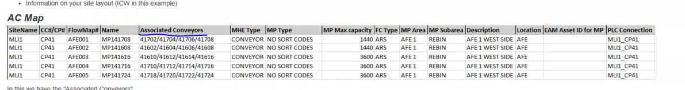
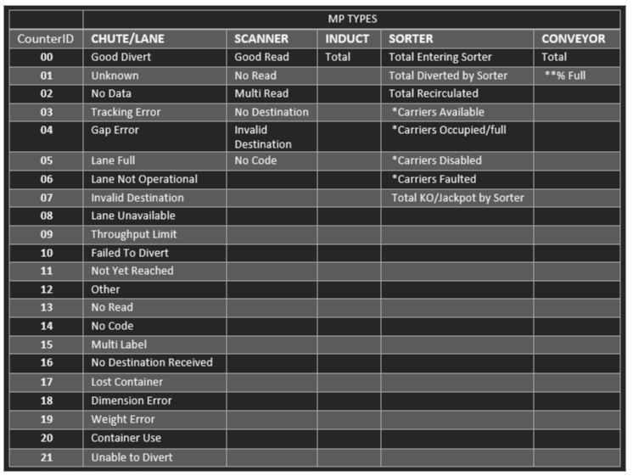
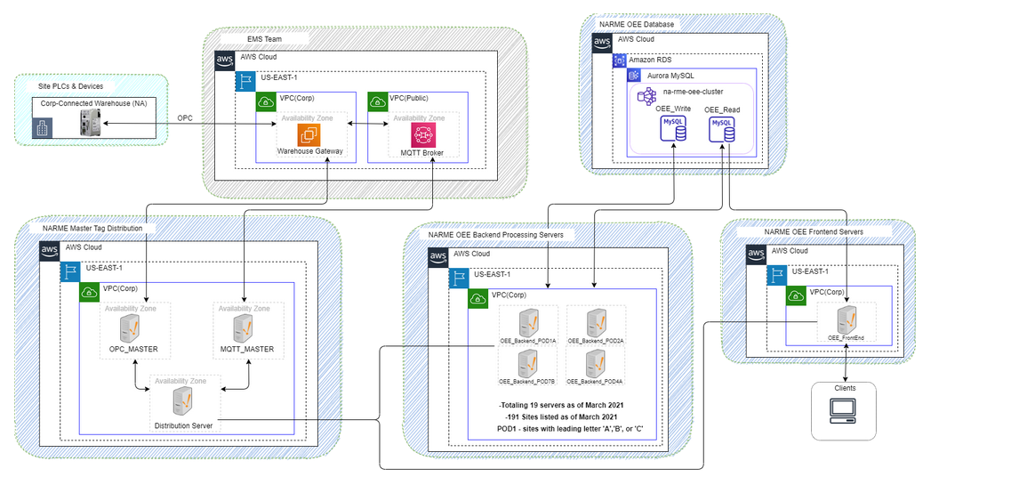
Global RME Jam Program
Automated Jam Detection and OEE Data Collection
Photo eye Sensor
Product Flow
Package
Associated Conveyor 41702
Photo eye Sensor
Associated Conveyor 41708
Conveyor
Package
Package
Product Flow
Associated Conveyor 41706
PLC
Photo eye Sensor
Note: During the Product flow process, the three (3) PE’s gets classified under one (1) MP. The conveyors gets merged into one (1) MP configuration. Hence, if multiple “Jam” occurs down the line, “ONLY” one (1) event would be captured in this example
*The MP will only report a jam for the tags it references in the PLC
Jam Collection Flow Map
AC Map Table
MP Type Table
Global Jam Program 2025
Data Infrastructure

